Slide 1
Decision Tree Learning

Slide 2
Introduction
Decision tree learning is one of the most widely used and practical methods for inductive inference.
It is a method for approximating discrete-valued functions, in which the learned function is represented by a decision tree.
It is robust to noisy data and capable of learning disjunctive expressions.
decision tree learning algorithms that includes widely used algorithms such as ID3, CART, and C4.5.
Learned trees can also be re-represented as sets of if-then rules to improve human readability.
Decision tree algorithms transform raw data to rule based decision making trees.

Slide 3
DECISION TREE REPRESENTATION

Slide 4
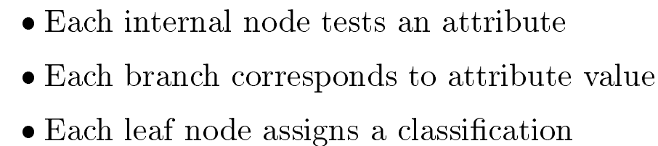

Slide 5
APPROPRIATE PROBLEMS FOR DECISION TREE LEARNING
Instances are represented by attribute-value pairs. Instances are described by a fixed set of attributes (e.g., Temperature) and their values (e.g., Hot, Mild, Cold)
The target function has discrete output values. assigns a Boolean classification (e.g., yes or no) to each example.
Disjunctive descriptions may be required.
The training data may contain errors. Decision tree learning methods are robust to errors, both errors in classifications of the training examples and errors in the attribute values that describe these examples.
The training data may contain missing attribute values. Decision tree methods can be used even when some training examples have unknown values.

Slide 6
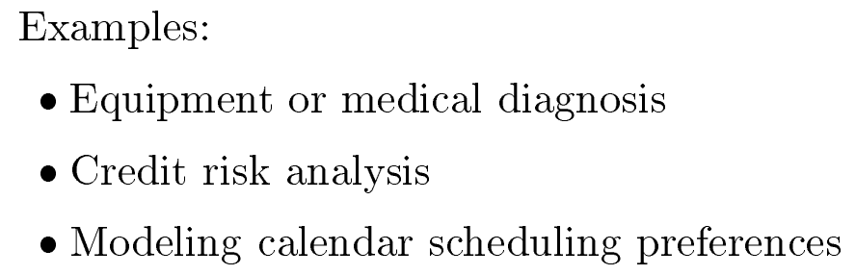
Example

Slide 7
Different Algorithms for Decision Tree
ID3
CART
C4.5

Slide 8
ID3 Algorithm
ID3 is one of the most common decision tree algorithm.
Firstly, It was introduced in 1986 and it is acronym of Iterative Dichotomiser.
Dichotomisation means dividing into two completely opposite things.
So, the algorithm iteratively divides attributes into two groups which are the most dominant attribute and others to construct a tree.
Then, it calculates the entropy and information gains of each attribute.
In this way, the most dominant attribute can be founded.
After then, the most dominant one is put on the tree as decision node. Thereafter, entropy and gain scores would be calculated again among the other attributes.
Thus, the next most dominant attribute is found.
Finally, this procedure continues until reaching a decision for that branch.
That’s why, it is called Iterative Dichotomiser.

Slide 9

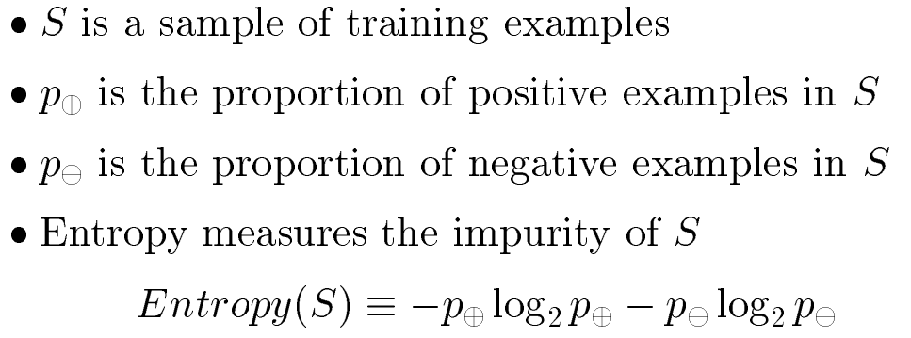
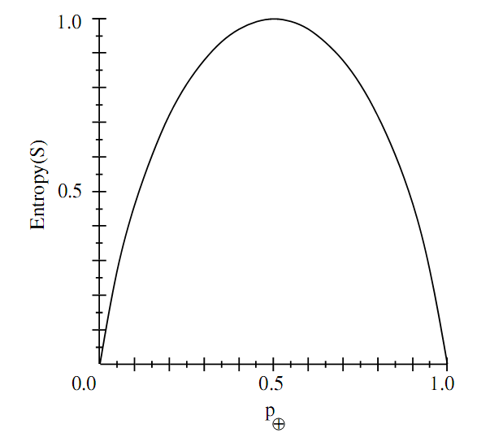

Slide 10
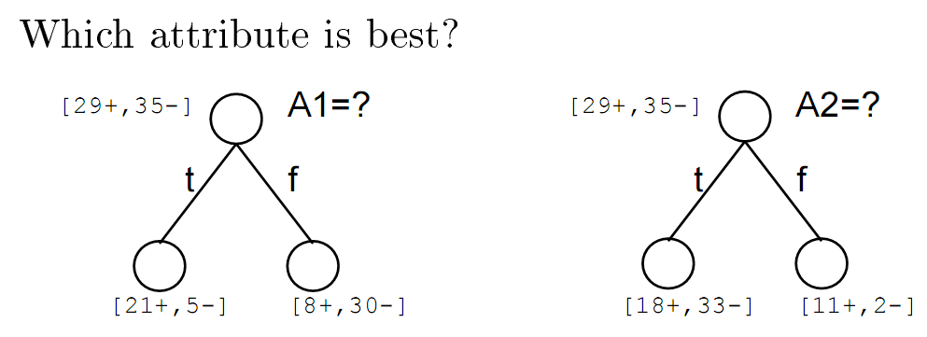
Which Attribute Is the Best Classifier?
What is a good quantitative measure of the worth of an attribute?
We will define a statistical property, called information gain.

Slide 11
Entropy and Information Gain
Entropy(S) = ∑ – p(I) . log₂p(I)
Gain(S, A) = Entropy(S) – ∑ [ p(S|A) . Entropy(S|A) ]

Slide 12
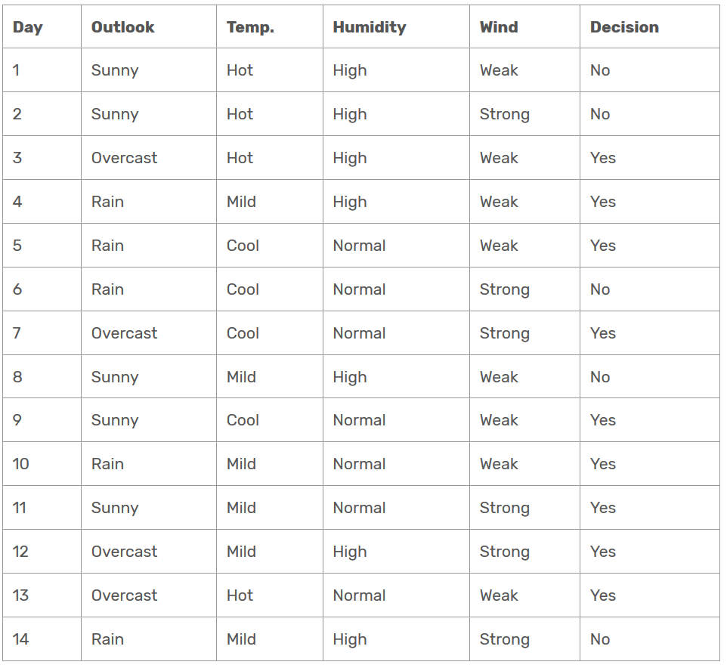
Data set

Slide 13
Entropy
We need to calculate the entropy first.
Decision column consists of 14 instances and includes two labels: yes and no.
There are 9 decisions labeled yes, and 5 decisions labeled no.
Entropy(Decision)
= – p(Yes) . log₂p(Yes) – p(No) . log₂p(No)
=– (9/14) . log₂(9/14) – (5/14) . log₂(5/14)
=0.940
Now, we need to find the most dominant factor for decision.

Slide 14
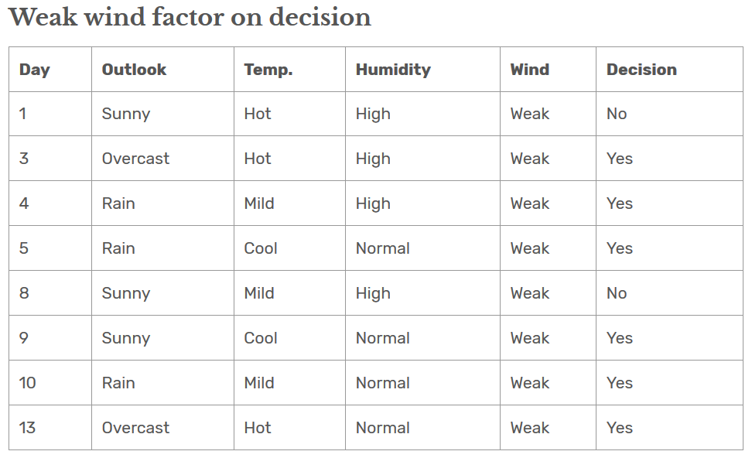
Wind factor on decision
Gain(Decision, Wind) = Entropy(Decision) – ∑ [ p(Decision|Wind) . Entropy(Decision|Wind) ]
Wind attribute has two labels: weak and strong.
Now, we need to calculate (Decision|Wind=Weak) and (Decision|Wind=Strong) respectively.
. There are 8 instances for weak wind. Decision of 2 items are no and 6 items are yes.

Slide 15
Entropy(Decision|Wind=Weak) = – p(No) . log₂p(No) – p(Yes) . log₂p(Yes)
Entropy(Decision|Wind=Weak) = – (2/8) . log₂(2/8) – (6/8) . log₂(6/8) = 0.811

Slide 16
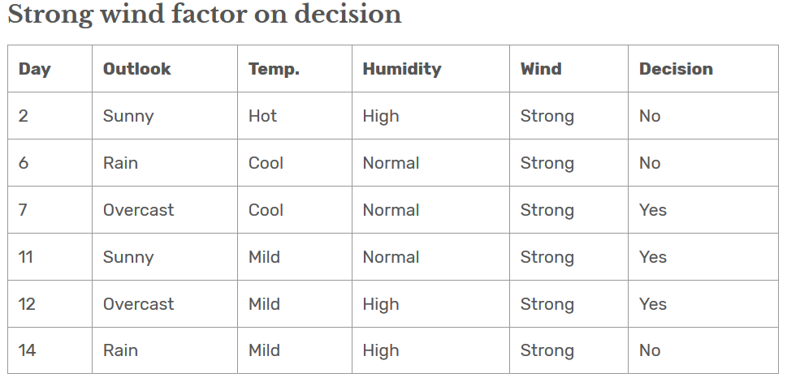
Here, there are 6 instances for strong wind. Decision is divided into two equal parts.
Entropy(Decision|Wind=Strong) = – p(No) . log₂p(No) – p(Yes) . log₂p(Yes)
Entropy(Decision|Wind=Strong) = – (3/6) . log₂(3/6) – (3/6) . log₂(3/6) = 1

Slide 17
Now compute Gain(Decision, Wind)
Gain(Decision, Wind) =
Entropy(Decision) – [ p(Decision|Wind=Weak) . Entropy(Decision|Wind=Weak) ]
– [ p(Decision|Wind=Strong) . Entropy(Decision|Wind=Strong) ]
=0.940 – [ (8/14) . 0.811 ] – [ (6/14). 1] = 0.048
Calculations for wind column is over. Now, we need to apply same calculations for other columns to find the most dominant factor on decision.

Slide 18
Outlook Factor on decision
outlook attribute has three labels: sunny, rain and overcast.
Now, we need to calculate (Decision|outlook=sunny) , (Decision|outlook=overcast) and (Decision|outlook=rain).

Slide 19
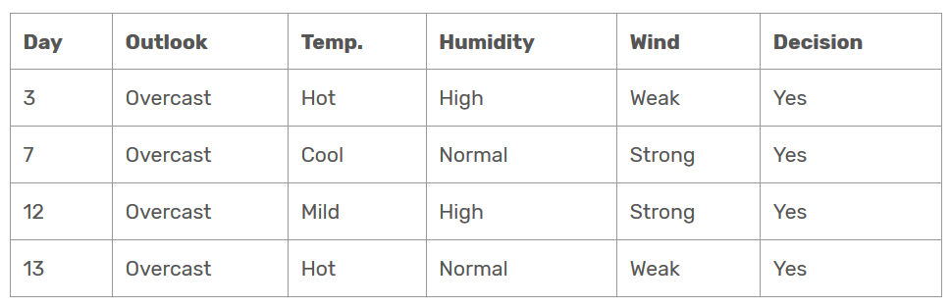
Here, there are 4 instances for outlook=overcast. Decision is consisting only yes.
Entropy(Decision|outlook=overcast) = – p(No) . log₂p(No) – p(Yes) . log₂p(Yes)
Entropy(Decision|outlook=overcast) = – (0/4) . log₂(0/4) – (4/4) . log₂(4/4) = 0
If Entropy is zero, that means data is belonging to single class.
We can analyse data from table as well, that all examples are falling in ‘yes’ class.

Slide 20
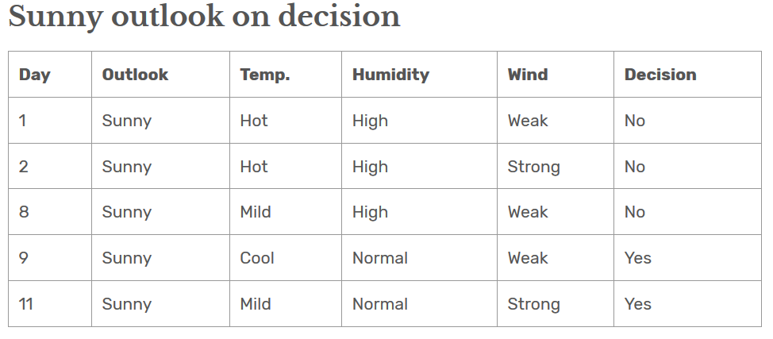
Here, there are 5 instances for outlook=sunny. Decision of 3 items are No and decision of 2 items are yes.
Entropy(Decision|outlook=sunny) = – p(No) . log₂p(No) – p(Yes) . log₂p(Yes)
Entropy(Decision|outlook=sunny) = – (3/5) . log₂(3/5) – (2/5) . log₂(2/5) = 0.971

Slide 21
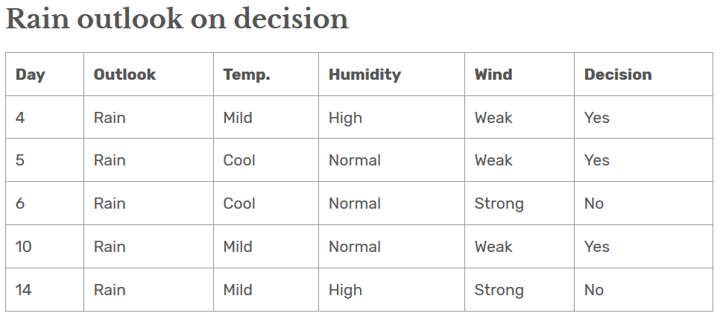
Here, there are 5 instances for outlook=rain. Decision of 2 items are No and decision of 3 items are yes.
Entropy(Decision|outlook=rain) = – p(No) . log₂p(No) – p(Yes) . log₂p(Yes)
Entropy(Decision|outlook=rain) = – (2/5) . log₂(2/5) – (3/5) . log₂(3/5) = 0.971

Slide 22
Now compute Gain(Decision, outlook)
Gain(Decision, outlook) =
Entropy(Decision)
– [ p(Decision|outlook=overcast) . Entropy(Decision|outlook=overcast) ]
– [ p(Decision|outlook=sunny) . Entropy(Decision|outlook=sunny) ]
- [ p(Decision|outlook=rain) . Entropy(Decision|outlook=rain) ]
=0.940 – [ (4/14) . 0 ] – [ (5/14). 0.971] - [ (5/14). 0.971] = 0.246

Slide 23
Exercise
Similarly, compute gain for humidity and temperature

Slide 24
Information Gain of All Attributes
1- Gain(Decision, Outlook) = 0.246
2- Gain(Decision, Temperature) = 0.029
3- Gain(Decision, Humidity) = 0.151
4-Gain(Decision, Wind) = 0.048
As seen, outlook factor on decision produces the highest score.
That’s why, outlook decision will appear in the root node of the tree.

Slide 25
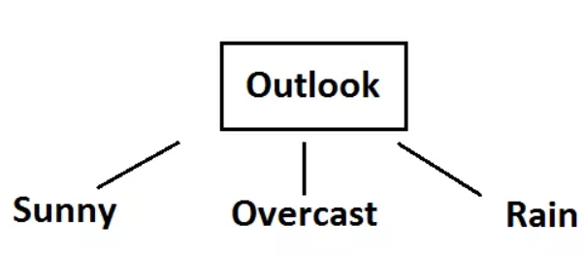

So, Root node of Decision Tree

Slide 26
Second Level (Outlook = sunny)
Now, we need to test dataset for custom subsets of outlook attribute.
1- Gain(Outlook=Sunny|Temperature) = 0.570
2- Gain(Outlook=Sunny|Humidity) = 0.970
3- Gain(Outlook=Sunny|Wind) = 0.019
Now, humidity is the decision because it produces the highest score if outlook were sunny.

Slide 27
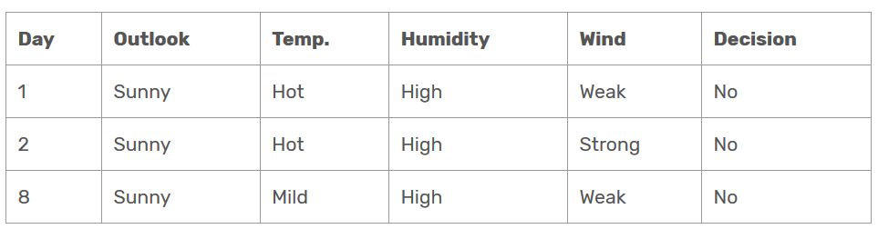
At this point, decision will always be no if humidity were high.

Slide 28
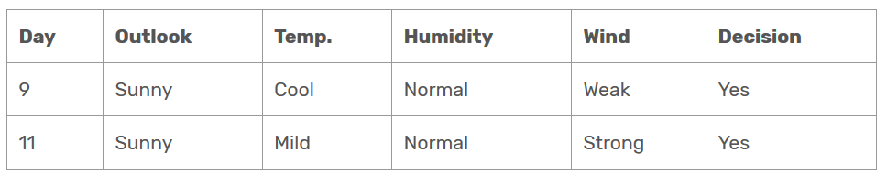
On the other hand, decision will always be yes if humidity were normal

Slide 29
Second Level (Outlook = Rain)
1- Gain(Outlook=Rain | Temperature) = 0.01997309402197489
2- Gain(Outlook=Rain | Humidity) = 0.01997309402197489
3- Gain(Outlook=Rain | Wind) = 0.9709505944546686
Here, wind produces the highest score if outlook were rain.
That’s why, we need to check wind attribute in 2nd level if outlook were rain.

Slide 30
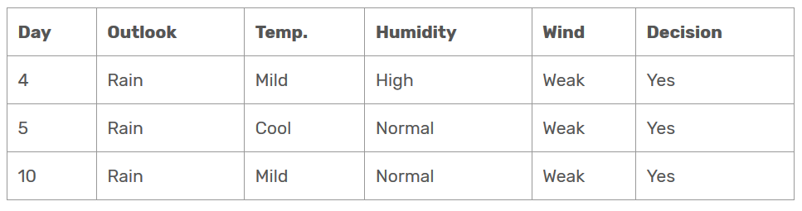
So, it is revealed that decision will always be yes if wind were weak and outlook were rain.

Slide 31
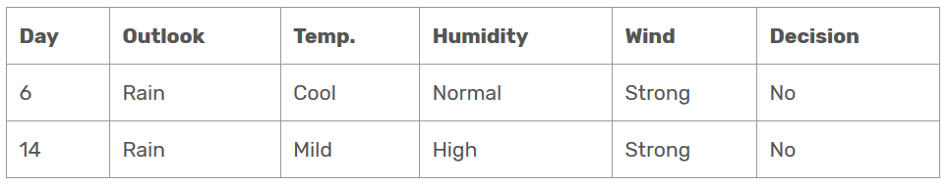
Decision will be always no if wind were strong and outlook were rain.

Slide 32
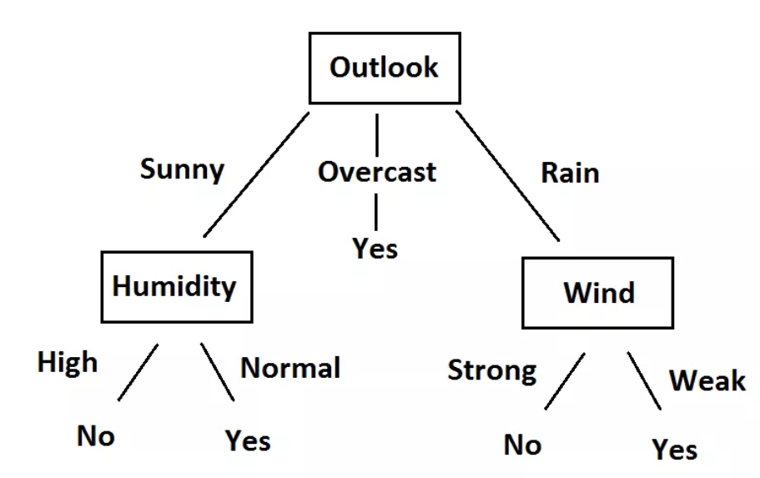
Final Decision Tree

Slide 33
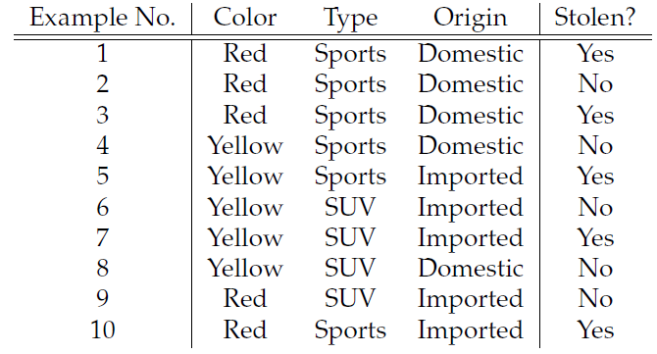
Exercise

Slide 34
Thank You !!!

